Slide 1
Classification and Sentiment
W266: Natural Language Processing

Slide 2
The plan...
Oh wow, I was not ready for this week’s async!
Project
Classification problems
ML and Neural Network Basics

Slide 3
Final Project:
Overview + Model Zoo
W266: Natural Language Processing

Slide 4
Peeking ahead...
Week 1: Introduction
Week 2: Classification & Sentiment
Week 3: Convolutional Neural Networks (CNNs)
Week 4 - 5: Language Models
Week 6 - 7: Machine Translation
Week 8: Summarization
Week 9: Part-of-Speech Tagging
Week 10 - 11: Dependency Parsing, Constituency Parsing
Week 12: Information Retrieval
Week 13: Entities

Slide 5
Peeking ahead...
Week 1: Introduction
Week 2: Classification & Sentiment
Week 3: Convolutional Neural Networks (CNNs)
Week 4 - 5: Language Models
October 7: Project Proposals Due
Due only 1 week after assignment 2. Don’t leave to the last minute!
Week 6 - 7: Machine Translation
Week 8: Summarization
Week 9: Part-of-Speech Tagging
Week 10 - 11: Dependency Parsing, Constituency Parsing
Week 12: Information Retrieval
Week 13: Entities

Slide 6
Final Project
This is all on the course GitHub!
-> Final Project Guidelines <-
Open-ended final project - your chance to explore & apply NLP!
Some project types:
Apply existing NLP algorithm(s) to a new dataset
Develop a new NLP algorithm or technique
Adapt techniques from a recent paper to a new domain
Use NLP algorithms to find patterns or trends in data
One requirement: language must be the main part of your project.
Notes:
Applied projects more common, but you’re encouraged to explore more abstract or fundamental computational linguistics tasks! (these tend to be fun projects)
All projects will require reading the literature for background, related work, and importantly, ideas.

Slide 7
Final Project: Timeline
Paper Reading Sessions (See Piazza!)
Project proposal (Oct 7th)
Milestone (Optional)
Final presentations (in-class December 10-14)
Project write up (due December 7)
In total, 60% of course grade! Important to start early.

Slide 8

Halp! Where should I start?

Slide 9
Finding Ideas and Datasets
Best source: read papers! See what people have tried, what data they used.
The Association of Computational Linguistics (ACL) Anthology
NAACL, ACL, EMNLP, NIPS, ICML, SigKDD, WSDM
Google Scholar and the arXiv (quality may vary)
More here: Project Proposal Guidelines
Stanford posts open lists of class projects:
cs224n (2000-2017), cs224d (2015, 2016, 2017)

Slide 10
Types of Problems
NLP ≈ (machine learning) + (linguistics) + (all sorts of algorithms)
Text classification / regression
Information retrieval / information extraction
Textual similarity
Sequence labeling
Summarization
Machine translation
Question answering
Semantics, natural language inference
Dialog
Notes:
Intuition and domain understanding are very important! Pick a problem that you find exciting. Don’t be afraid to skip ahead in the course readings & async to learn more about a topic of interest.
Semantics, NLI, and dialog aren’t covered in this course - but we’re happy to talk about them!

Slide 11
Types of Models
Be sure to use the right tool for the job! The literature is a great resource here, but there are many models we won’t see until later in the course.
Different problems use different ML architectures:
Unsupervised
Classification or regression
Sequence labeling
Retrieval, extraction, and similarity
Sequence prediction

Slide 12
Finding Data
Data is usually the limiting factor in NLP problems (as with most ML)
Most tasks in the async have lots of data available
Interested in a new domain? Be sure you can get data!
Potential data types / sources:
Labeled corpora (Penn Treebank, sentiment data, much, much more)*
Large corpora (Gigaword, Wikipedia, Common Crawl, Google Web 1T)
News articles (NYT, WSJ, Reuters, etc.)
Social media (reddit, Twitter, etc.)
???
Notes:
Lots of text that has some structure associated with is, which often lends itself to rich machine learning tasks. For example: summarization data is (historically) often derived from news headlines, paired with the articles. Or reddit, which has upvotes and comment thread structure.

Slide 13
Getting Data
Have access to many paywalled corpora through UC Berkeley
Linguistic Data Consortium corpora:
Recent corpora: http://oskicat.berkeley.edu/search~S1?/aLinguistic+Data+Consortium%7C
Older corpora: http://blc.berkeley.edu/collections_and_archives/

Slide 14
Common pitfalls
If you only remember two things…
Read existing research. (Do not start from scratch!)
Look at your data before you submit your proposal.
(Corollary: if you want to scrape data, start working on that now)
Notes:
Data collection & processing takes more time than you think - don’t leave it to the last minute and find yourself without time to do the fun parts (experiments)!

Slide 15
Text Classification
W266: Natural Language Processing

Slide 16
Text Classification from a ML perspective
Input:
x = [this is a sentence, and we want to classify it.]
Output:
y ∈ {0, 1} or y ∈ {0,...,k}
Applications:
Sentiment polarity (y ∈ {negative, positive})
Document classification (y ∈ {categories})
(...)
Notes:
But this is just the surface!

Slide 17
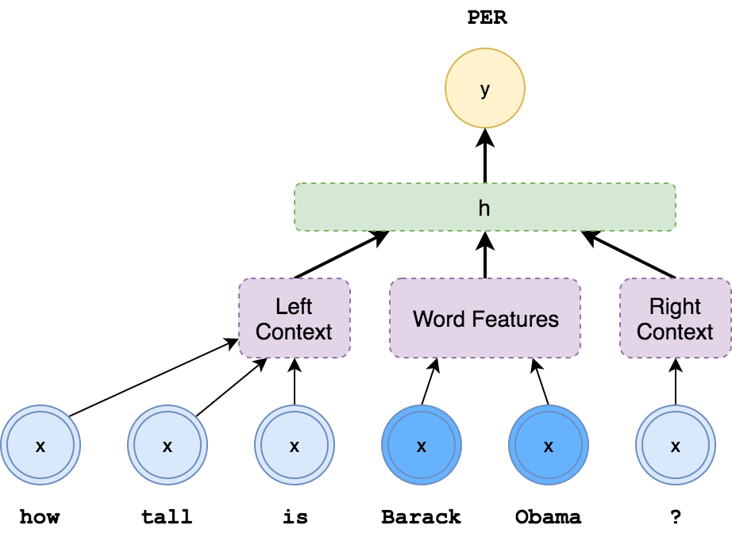
Text Classification Tasks
Example: named entity tagger (NER)
Paraphrase detection:
x = (sentence_1, sentence_2)
y ∈ {0,1}
Entailment:
x = (sentence_1, sentence_2)
y ∈ {L-entail, R-entail, contradict, other}
POS or entity tagging*:
x = (word, nearby words)
y ∈ {NOUN, VERB, ADJ, …} or y ∈ {PER, LOC, ORG, …}
Parsing*:
x = (stack, buffer), y ∈ {shift, L-reduce, R-reduce}
Notes:
* For tagging and parsing and other structured prediction tasks (which we’ll discuss in weeks 7-11), simple classifiers are often a key component of high-performing systems. The classifier runs in a loop and extracts features from some state machine in order to make decisions that contribute to the final output.
Many reinforcement learning systems also work this way, where a simple classifier on the world state predicts an action to take.

Slide 18
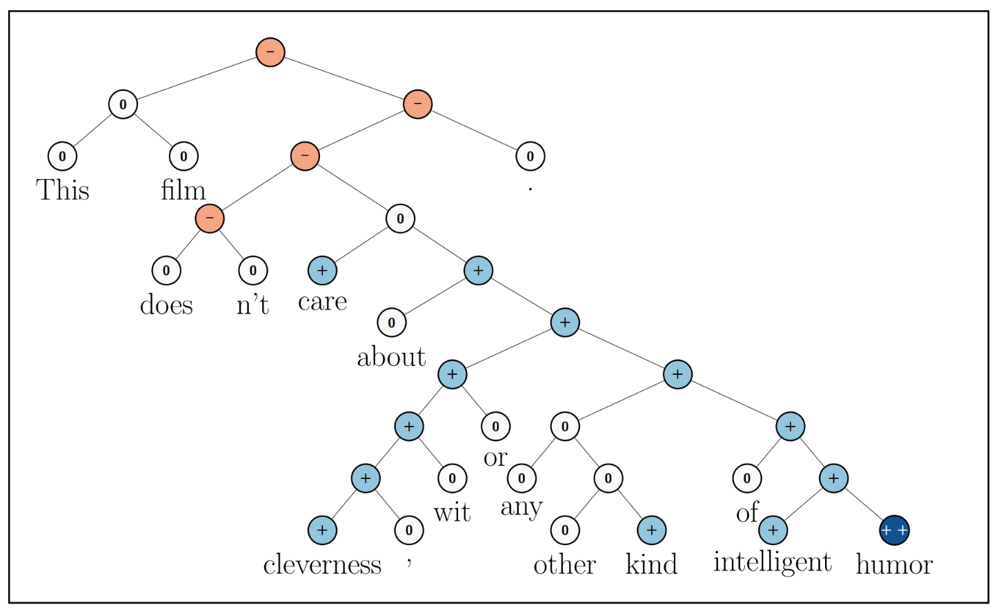
Sentiment Analysis
Given a text, predict whether it expresses positive or negative sentiment.
Variants Binary; star rating; Aspect Based Sentiment Analysis (ABSA); Distributional
Applications Market research; customer service; financial market predictions
Tricky for complex sentences!
In practice, simple methods work well.
Socher et al. (2013)

Slide 19
Why neural nets: drawbacks to simple tokens
Are there drawbacks of modeling all words separately?
Words that described similar types of things can be used in similar contexts. Specific contexts will not be observed with all words having the same type (e.g. city names)
What if we modeled: P(<city name> | "always wanted to visit")
Train like to fly to honolulu 20 just flew back from beijing 10 just flew back from boston 35 just flew back from honolulu 65 i grew up near dallas 5 I grew up near boston 3 moved back home from chicago 8 moved back home from dallas 8 always wanted to visit london 7 always wanted to visit boston 5 Evaluation/Application always wanted to visit beijing ?
Notes:
Would be nice if we can bridge between contexts, by multi-hop reasoning: {beijing, boston, honolulu} are similar, and {boston, london} are similar, so maybe {london, beijing} are similar, transitively?

Slide 20
Why Neural Nets?
Powerful learned representations
Input: Word embeddings
Internal: Multiple hidden layers to refine representation
Both learn jointly with task objective!
Deep computation (multiple layers) allows
Complex decision boundary
Fewer parameters than big shallow network
Key: avoid sparsity problem by computing in dense space
Without sacrificing representation power
Notes:
Of course, must always be careful to avoid overfitting. Neural networks can be very powerful, and overfit in more subtle ways than big sparse models.

Slide 21
Mathematically equivalent: one-hot & word vectors
Usually presented as a “lookup” in some table, but…
Think of a word as a one-hot vector: X = [0 0 1 … 0 0 0 …. 0 0 0]
Then we do matrix multiplication:
0
0
1
0
0
0
0
E =
W^{T}
“the”
X
Word Embeddings!
Vector for “the”
Reasonable that similar words end up with similar vectors
Notes:
Key idea: map discrete things (words) into a continuous feature space.
Conceptually, just a big matrix multiply. But since one-hot vector is very sparse, convenient to just extract the column by indexing. So often we’ll refer to this as a “lookup”. (In fact, you can even shard embeddings across different servers, and just pull in the one you need!)

Slide 22
Neural Bag of Words Model
Sigmoid Or Softmax
Affine
z = xW + b
Affine
Nonlinearity
Affine
Sum vectors
(“bag of words”)
+
e₁ e₂ e₃ e₄ e₅
w₁ w₂ w₃ w₄ w₅
Notes:
2-4 minute slide. Discuss network end-to-end starting with input word embeddings, summation to get sentence representation, feed through DNN layers and then used for softmax classification.

Slide 23
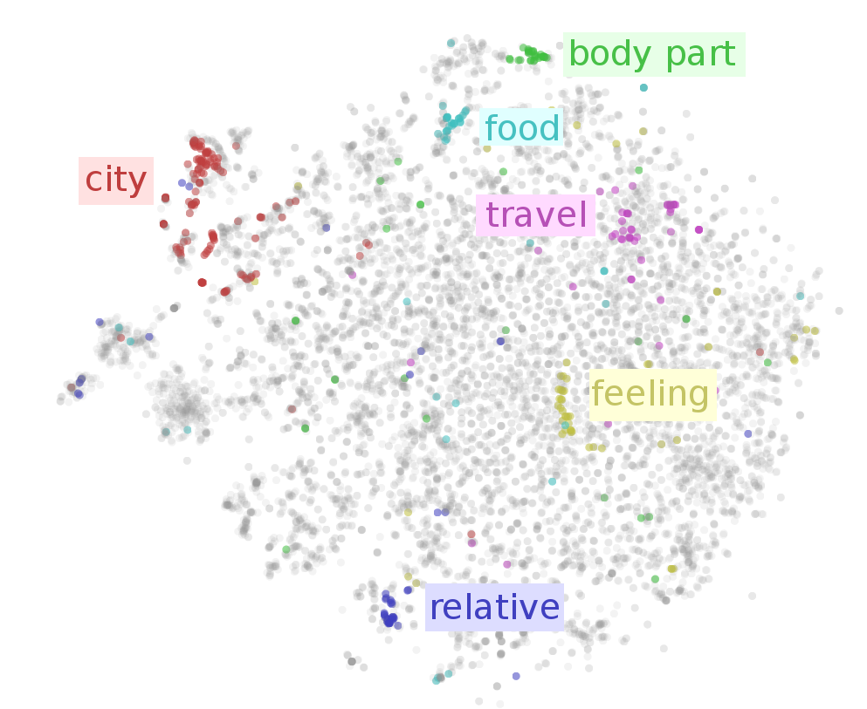
Interpreting Representations
Related words appear nearby in embedding space.
Note: visualization is approximate! (typically, d = 50-300)
Image from Visualizing Representations (Chris Olah, 2015)
Also see http://projector.tensorflow.org/

Slide 24
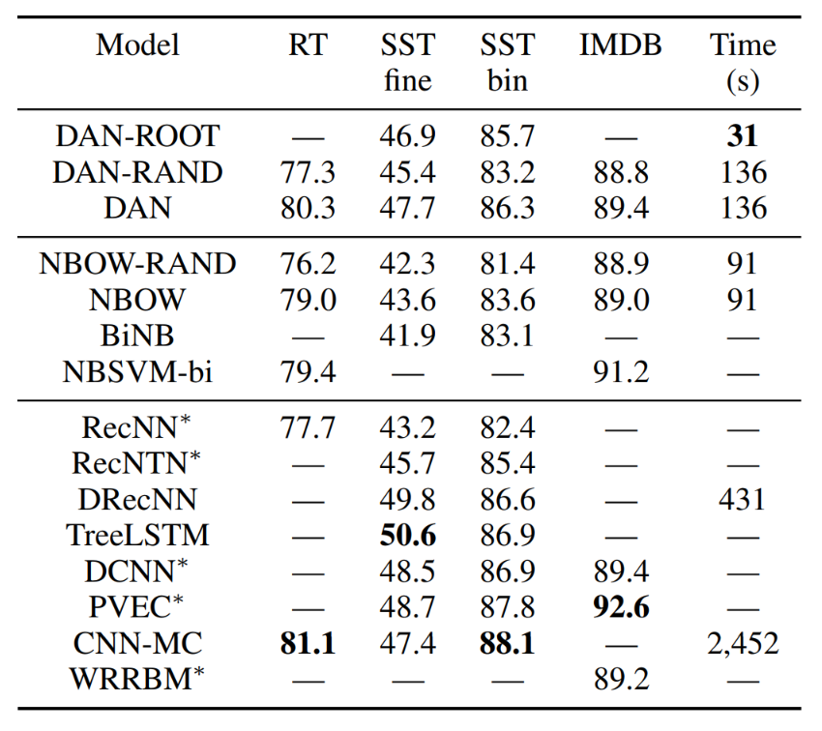
Effectiveness
Deep Unordered Composition Rivals Syntactic Methods for Text Classification (Iyyer et al., 2015)
Deep Averaging Network (DAN)
Fast! Easy to Implement! + Competitive with more sophisticated models

Slide 25
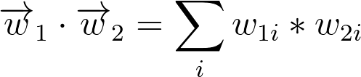
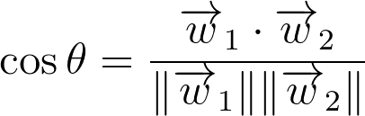
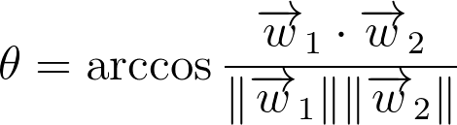
Word-to-Word Similarity
Dot product Scores overlapped between individual words However...score is unnormalized Larger vectors get higher scores
Cosine Normalizes dot product by vector length However...scores can violate triangle inequality sim (a, c) ≤ sim(a,b) + sim(b,c)
Arccosine Converts to angular distance Triangle inequality now holds!
bike
car
truck
Notes:
\overrightarrow{w}_{1} \cdot\overrightarrow{w}_{2} = \sum_i w_{1i}*w_{2i}
\cos \theta = \frac{\overrightarrow{w}_{1} \cdot\overrightarrow{w}_{2} }{\|\overrightarrow{w}_{1}\| \|\overrightarrow{w}_{2}\|}
\theta = \arccos \frac{\overrightarrow{w}_{1} \cdot\overrightarrow{w}_{2} }{\|\overrightarrow{w}_{1}\| \|\overrightarrow{w}_{2}\|}

Slide 26
Unsupervised training
Training word representations without a supervised task!!!
Key idea Word representations should predict their context and vice versa. Mechanisms
Skip-gram: Train representations to predict context around a word CBOW: Train representation to predict word from surrounding context
Notes:
Distributional hypothesis: let’s try to learn meaning of words (as vector representation), by predicting the words around them.

Slide 27
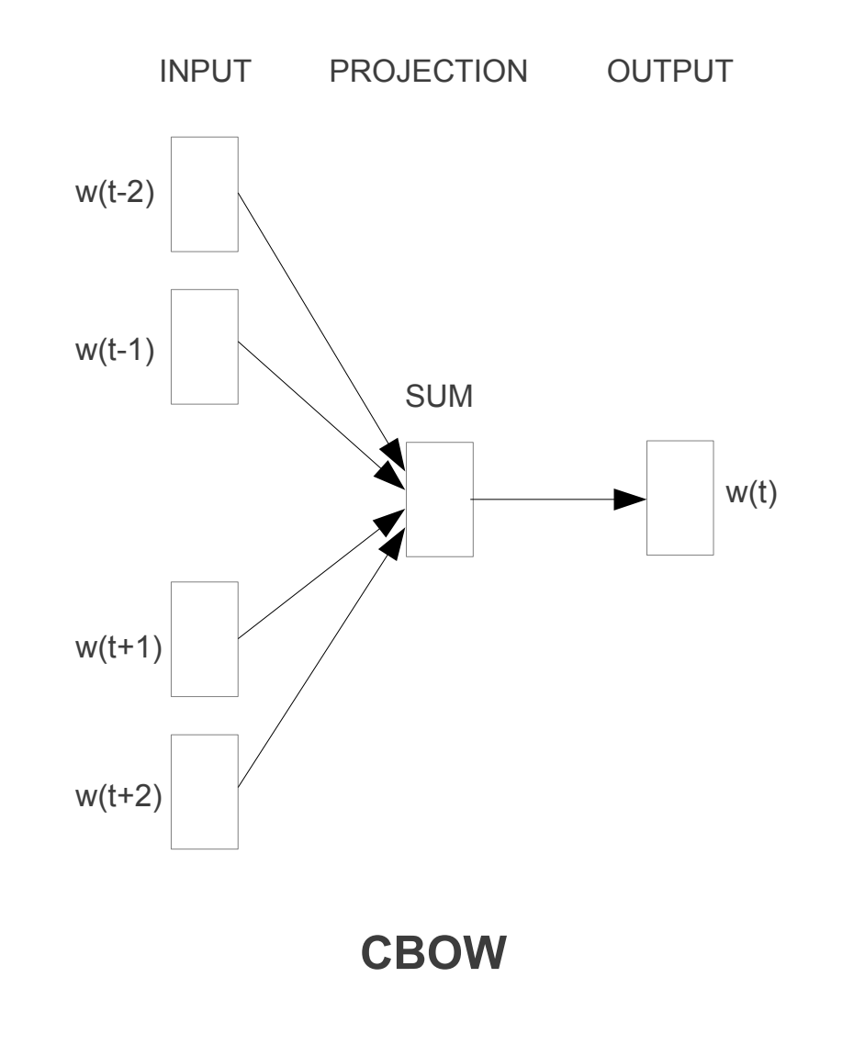
CBOW: Continuous Bag-of-Words
Predicts a word given its context - P(word|context)
Mechanism Averages vectors for context words Current word predicted using avg. context representation. Maximizes P(word | avg(context)
Mikolov et al., 2013

Slide 28
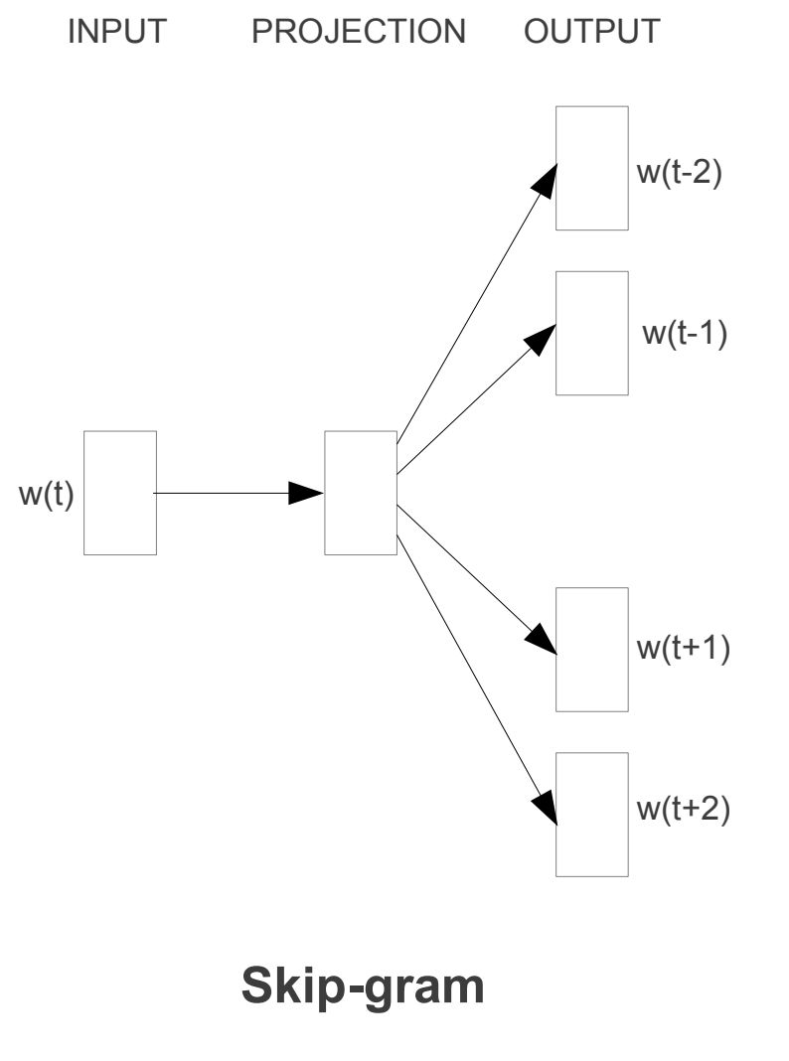
Skip-Gram
Predicts context around a word - P(context|word)
Mechanism Randomly samples R words from context window Maximizes P(context_{i∈R} | word_{t})
Mikolov et al., 2013

Slide 29
Combining Supervised+Unsupervised
Sigmoid Or Softmax
Supervised task Trains hidden and output layers
Unsupervised task Trains word embeddings
Why?
Affine
Nonlinearity
Supervised (e.g., Sentiment)
Affine
Sum vectors
(“bag of words”)
+
e₁ e₂ e₃ e₄ e₅
Unsupervised (e.g., Word2Vec)
w₁ w₂ w₃ w₄ w₅

Slide 30
Combining Supervised+Unsupervised
Sigmoid Or Softmax
Supervised task Trains hidden and output layers
Unsupervised task Trains word embeddings
Why?
More unsupervised than supervised data
Word level task transfer
Effectiveness depends on task and quantity of supervised data.
Affine
Nonlinearity
Supervised (e.g., Sentiment)
Affine
Sum vectors
(“bag of words”)
+
e₁ e₂ e₃ e₄ e₅
Unsupervised (e.g., Word2Vec)
w₁ w₂ w₃ w₄ w₅

Slide 31
Word Embeddings Summary
Independently useful - captures semantic similarity between words.
Natural product of training a neural network on a natural language task.
However, does not require a supervised task!
Unsupervised Methods Word2Vec GloVe FastText Misc. others...
Allows for combination of supervised and unsupervised training
Notes:
Others include: LexVec, Paragram, C-PHRASE

Slide 32
Back to Classification
Beyond Neural Bag-of-Words
Convolutional Neural Networks Week 3
Shared weights and incremental local pooling for better representations
Recurrent Neural Networks Week 5
Sequentially processes text with hidden state tracking current interpretation
Pooling
The
cat
in
the
Shared Weights
The
cat
in
the

Slide 33
Implementation Details: Tuning Hyperparameters
Many things to try:
Vocabulary size
Word vector size
Hidden layer size
Learning rate
Minibatch size and training schedule
Sampled loss functions?
Dropout?
Optimizer (SGD, AdaGrad, Adam, RMSProp, etc.)?
True for non-neural algorithms too! But NNs can be very sensitive.

Slide 34
Implementation Details: Tuning Hyperparameters
How to tune?
Guess sensible defaults, based on similar work
We’ll give you these for assignments
Grid search: try all combinations (slow!)
Alpha = [0.1, 0.01, 0.001]
Lambda = [1.0, 0.1, 0.01]
H = [50, 100, 200, 500]
Random search (much better!)
Fancy: automatic tuning (gaussian processes, etc.)
No perfect solution...

Slide 35
Implementation Details: Debugging TensorFlow
How to debug?
Many errors checked at graph construction
Look at Tensor shape: tf.shape(x_) or x_.get_shape(), like in NumPy
Test on small data:
output = session.run(output_, feed_dict={input_: inputs[:3]})
TF does a lot for you! Use high-level functions instead of rolling your own.
tf.nn.embedding_lookup(...)
tf.nn.dynamic_rnn(...)
tf.nn.sparse_softmax_cross_entropy_with_logits(...)
And many more!

Slide 36
End.
Next week Convolutional Neural Networks (CNNs)

